Slide 1
Power Operation 2021 Launch Design & Quote Delta
May 27, 2021
Rich Alexander: Power Operation offer manager
Madleen Laclef: Digital Power launch leader
For Schneider Electric and EcoXpert partners

Slide 2
PO 2021 Launch
Design & Quote Delta
1 – Introductions
2 – Power Operation 2021 Launch Schedule
3 – Finding Power Operation 2021 resources / collateral
4 – Power Operation 2021 What’s New (Promote & Sell recap)
5 – Design & Quote resources / collateral
6 – Design Guide What’s New
7 – How to Order Power Operation What’s New
8 – Your Questions
5’
5’
5’
10’
5’
40’
5’
15’

Slide 3
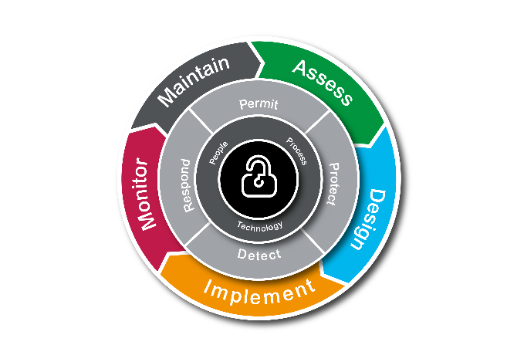
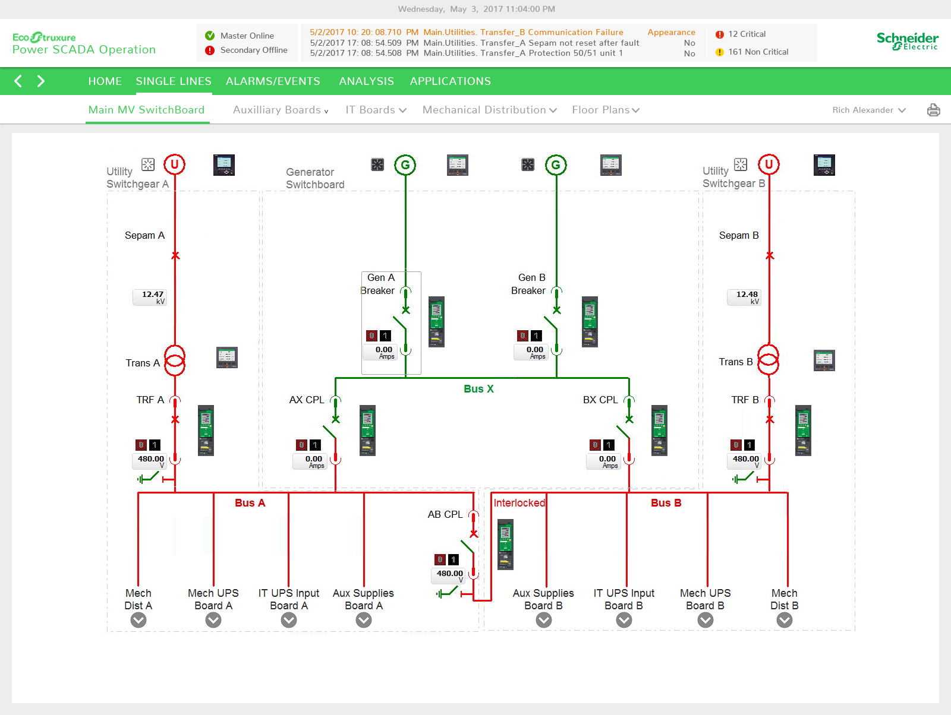
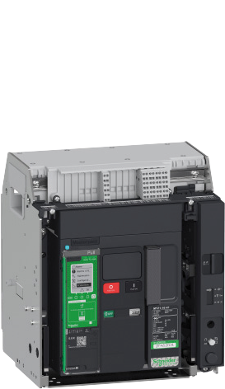
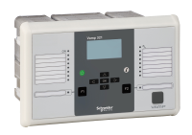
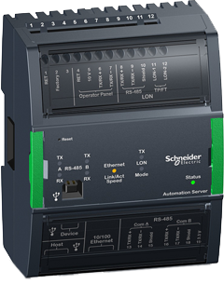
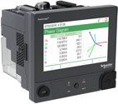
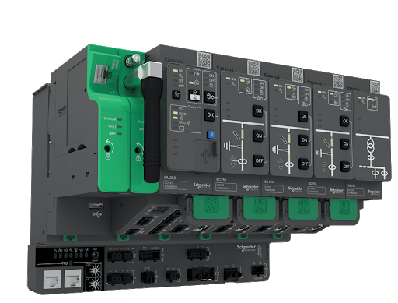
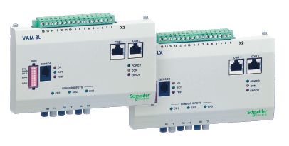
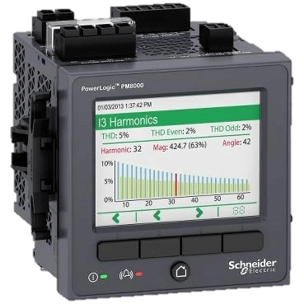
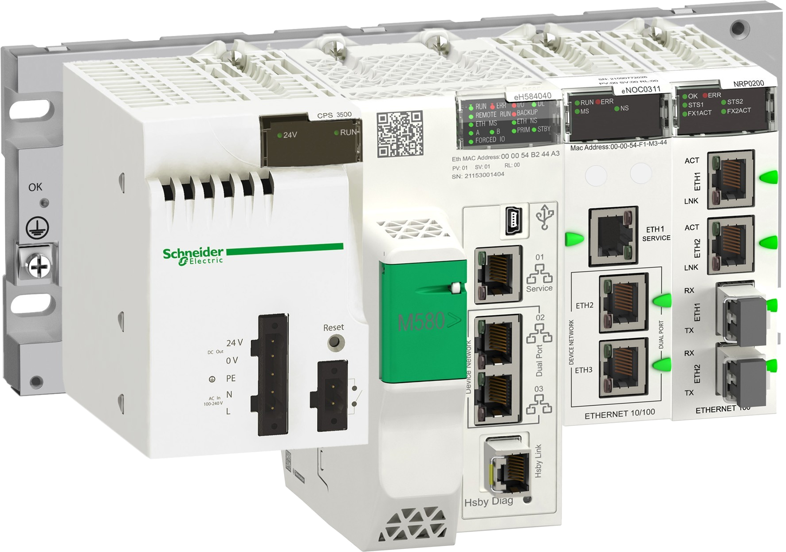
Introductions
Specialized edge control for Critical Facility Management
Host
Apps, Analytics & Services
Madleen Laclef
madleen.laclef@se.com
Digital Power
Launch Leader
Power Advisor
Digital Services
Cybersecurity
Global Services
Edge
Control
Presenter
IP Communications Backbone
Rich Alexander
Richard.Alexander@se.com
Power Operation
Global Offer Manager
Connected Products

Slide 4
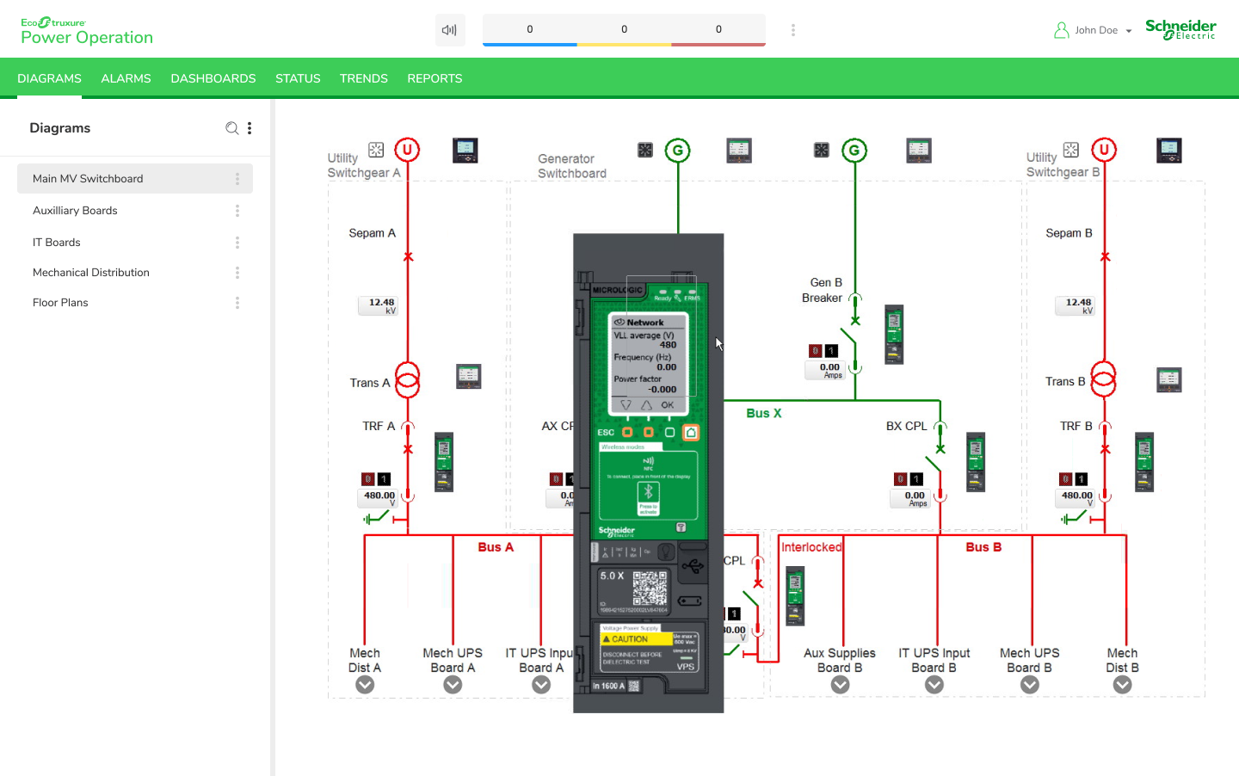
About Power Operation 2021
Overview
EcoStruxure Power Operation 2021 is:
Next generation of Power SCADA Operation (PSO), PowerSCADA Expert (PSE), PowerLogic SCADA (PLS)
Available June 30, 2021

Slide 5
PO 2021 Launch
Design & Quote Delta
1 – Introductions
2 – Power Operation 2021 Launch Schedule
3 – Finding Power Operation 2021 resources / collateral
4 – Power Operation 2021 What’s New (Promote & Sell recap)
5 – Design & Quote resources / collateral
6 – Design Guide What’s New
7 – How to Order Power Operation What’s New
8 – Your Questions
5’
5’
5’
10’
5’
40’
5’
15’

Slide 6
Launch Schedule
Activities before and after June 30 product availability
Q1 2021
Q2 2021
Q3 2021
February
March
April
May
June
July
August
February 11
Promote & Sell Delta webinars
March
Marcom assets available &
PSO 2020 R2 CU1
April
More Marcom assets available
May 27
Design & Quote Delta webinars
June 30
Power Operation 2021 available
July - August
Delta Technical Training
+
Digitalized commercial training
Audience:
Offer managers, sales engineers and tendering teams +
EcoXperts welcome to join
Is previous experience required:
Ideally yes
Link to P&S materials shared
Audience:
Offer managers, tendering teams, PAE’s and application engineers (optional) +
EcoXperts welcome to join
Is previous experience required:
Ideally yes
Audience:
SE application engineers & EcoXpert/partners
Is previous experience required:
Required
(take advantage of Power Operation Project Deployment to get ready)

Slide 7
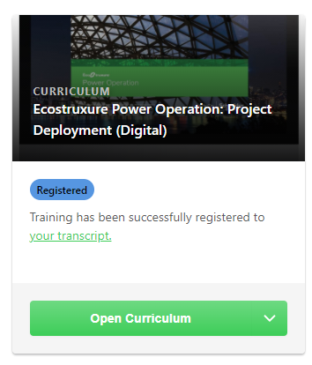
Zoom In - Power Operation technical training (PSO 2020 R2 now available)
Transforming from instructor lead to self-paced & on-demand training
Faster onboarding for new application engineers and ‘power’ end users via digital training available on-demand for self-paced learning
Content includes full digitalization of Project Deployment technical training
Accessible to Schneider Electric & EcoXperts via MyLearningLink
Approaching 500 individuals who have taken advantage of technical training videos since February 2021!

Slide 8
PO 2021 Launch
Design & Quote Delta
1 – Introductions
2 – Power Operation 2021 Launch Schedule
3 – Finding Power Operation 2021 resources / collateral
4 – Power Operation 2021 What’s New (Promote & Sell recap)
5 – Design & Quote resources / collateral
6 – Design Guide What’s New
7 – How to Order Power Operation What’s New
8 – Your Questions
5’
5’
5’
10’
5’
40’
5’
15’

Slide 9
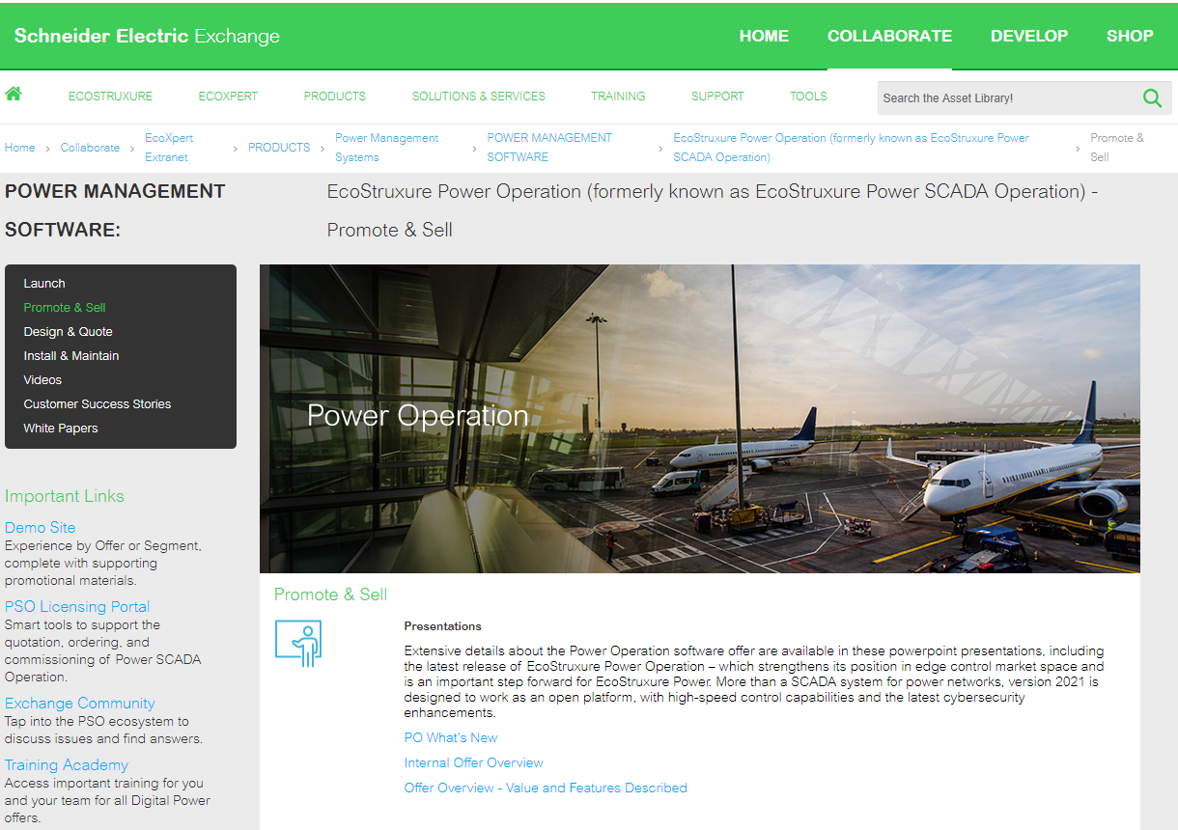
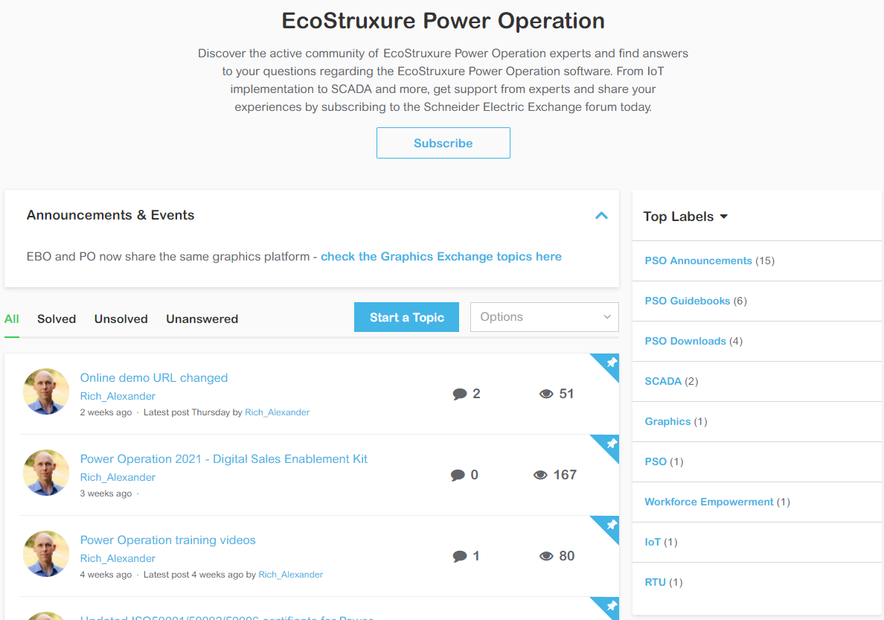
Resources to enable teams
Key tools
Exchange Extranet
Commercial collateral to download and share
Audience: Schneider Electric & EcoXperts
Exchange Extranet Link
Exchange Community
Access experts via discussion community, software downloads, find announcements, etc.
Audience: Schneider Electric & EcoXperts
Exchange Community Link

Slide 10
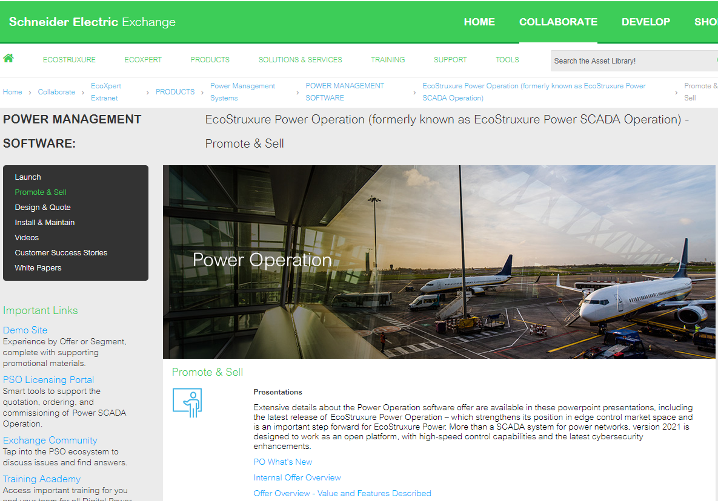
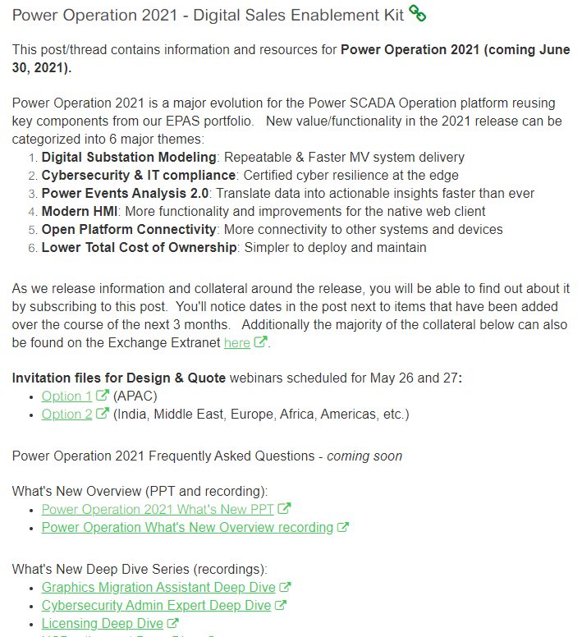
Power Operation 2021 collateral available in two places
Exchange Extranet and Exchange Community
+ ‘Deep dive’ recordings
& Discussions
OR
Promote & Sell - SE Exchange Extranet
Power Operation 2021 - Digital Sales Enablement Kit - Exchange Community

Slide 11
PO 2021 Launch
Design & Quote Delta
1 – Introductions
2 – Power Operation 2021 Launch Schedule
3 – Finding Power Operation 2021 resources / collateral
4 – Power Operation 2021 What’s New (Promote & Sell recap)
5 – Design & Quote resources / collateral
6 – Design Guide What’s New
7 – How to Order Power Operation What’s New
8 – Your Questions
5’
5’
5’
10’
5’
40’
5’
15’

Slide 12
Expanded protocol capabilities
OPC UA Client and Server
New scope not previously shared in February P&S
Adding support for OPC UA Server in Power Operation 2021
OPC UA Client previously introduced in PSO 9.0
OPC UA (Unified Architecture) is latest machine to machine communication technology for industrial automation developed by OPC Foundation.
Open Data Exchange
Client & Server

Slide 13
New scope not previously shared in February P&S
Introducing new Trial License mode
Making it easier for those looking to quickly ‘try out’ software
What is trial license
How does it work
A new trial license mode will be available for those looking to explore software without having to acquire a license.
Trial license mode will be automatically available after installing Power Operation 2021.
Allows use of Power Operation for 90 days after installation without need to apply a production license or development license
At anytime during the 90 day trial period, one can apply a Power Operation production license or Power Operation Development license if registered partner (EcoXpert or SE).
What is included in trial license
1 x PSA101199: Power Operation Server, Unlimited Points
2 x PSA102099: Power Operation Client Access, Unlimited Points
1 x PSA104113: Event Notification Module
1 x PSA104112: Advanced Reporting and Dashboards Module
1 x PSA104114: Energy Billing Module
1 x PSA104115: Breaker Performance Module
1 x PSA104116: Energy Analysis Reports Module
1 x PSA104121: Capacity Management Module
1 x PSA104124: Power Quality Performance Module
1 x PSA104125: Insultation Monitoring Module
1 x PSA104126: Backup Power Module

Slide 14
Recap from the What’s New PPT
Power Operation 2021 What’s New Summary
Digital Substation Modeling
Cybersecurity & IT Compliance
Power Events
Analysis 2.0
Open Platform Connectivity
Faster deployments via IEC 61850 Compliant Engineering for IEC 61850, Modbus & IEC 60870-5-104
Integration with EPAS-E (SET) via Profile Studio
IEC 61850 DNV certified
IEC 62443 4-2 SL2 certified
System level security management via Cybersecurity Admin Expert
IT compliant licensing (virtual machine friendly)
Part of IEC 62443 3-3 and 2-4 certifications
Support for IPv6 (previously released)
Quickly understand event cause via Natural Language Analysis of waveforms
Quantify event impact via Load Loss Detection
Identify location of PQ events via Disturbance Direction Detection (DDD)
See alarms in system context via built-in alarm to 1-line navigation
Reduce nuisance alarms via built-in alarm maintenance modes in web client
Optimize alarming to ensure effectiveness for operators via Power Advisor integration
OPC UA Server
Even more integration options with 3rd party systems via Smart Connector Framework
And more ‘Turn-key’ Modbus drivers
Simple to deploy & maintain
Easergy P5
Galaxy VS UPS
PowerTag 63A/HR/Rope
Acti9 Active
Updated MTZ 4.0 driver
Panel Server
HDPM (previously released)
Gutor UPS (previously released)
More efficient graphics reuse
Configurable graphics visibility levels for pan & zoom
Internet accessible, self-paced & on-demand technical training
Internet accessible technical documentation
And more…
Modern HMI
Any browser, any time
Even more functionality & improved performance in web client…
+ Previously released web Trends, control over web, graphics migration tool
Coming June 30, 2021
Notes:
14

Slide 15
Recap from the What’s New PPT
Power Operation 2021
Even more languages!
Language | Web client runtime | Web operator help | Engineering Tools | System Guide help
English | Yes | Yes | Yes | Yes
Simplified Chinese | Yes | Yes | Yes ¹ | Yes ¹
French | Yes | Yes | Yes ¹ | Yes ¹
Spanish | New for 2021 | New for 2021 | No | No
Swedish | New for 2021 | New for 2021 | No | No
German | New for 2021 | New for 2021 | No | No
Russian | New for 2021 | New for 2021 | No | No
Portuguese | New for 2021 | New for 2021 | No | No
Norwegian | New for 2021 | New for 2021 | No | No
Italian | New for 2021 | New for 2021 | No | No
Polish | New for 2021 | New for 2021 | No | No
¹ excluding Graphics Editor
Notes:
All of these languages are supported by Advanced Reporting as well

Slide 16
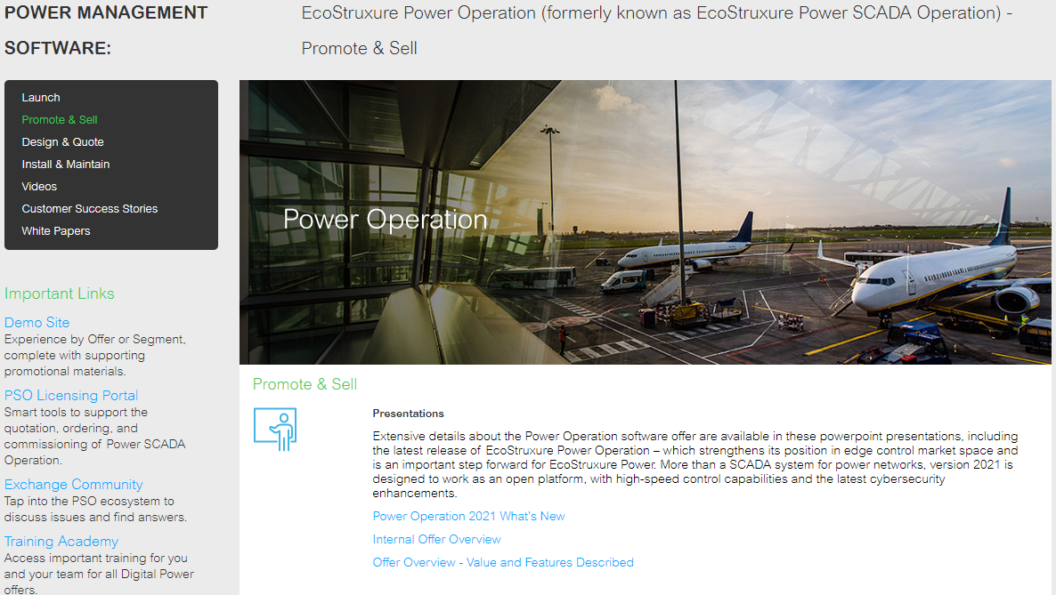
Where to find complete Power Operation 2021 What’s New
OR
Power Operation 2021 - Digital Sales Enablement Kit - Exchange Community
Promote & Sell - SE Exchange Extranet

Slide 17
Green highlighted items have been updated since February P&S
Power Operation 2021 collateral available
Promote & Sell collateral now available (1/4)
Collateral | Available on Extranet | Available on Community (SEK) | Description
Power Operation 2021 What’s New | Yes | Yes | What’s new versus PSO 2020 Now includes OPC UA Server
Power Operation Offer Overview – Value and Features Described | Yes | Yes | Power Operation end user facing overview of offer. Now includes OPC UA Server
Power Operation 2021 – Compelling reasons to upgrade | Yes | Yes | Reasons to upgrade from previous versions of PSO or Citect to Power Operation 2021. Now includes OPC UA Server
Power Operation Offer Overview – Internal (Business Playbook) | Yes | Yes | Not for end users. Intended for those looking to build new Power Operation business. Now includes OPC UA Server
Power Operation Name Evolution – Offer Statement | Yes | Yes | Letter from offer manager with statement that Power Operation is new name for PSO, PSE, PLS
Power Operation & PME support lifecycle | Yes | Yes | Document outlining various Power Operation and PME versions currently under full and/or limited support. Full support timeline extended by one year

Slide 18
Green highlighted items have been updated since February P&S
Power Operation 2021 collateral available
Promote & Sell collateral now available (2/4)
Collateral | Available on Extranet | Available on Community (SEK) | Description
Power Operation positioning | Yes | Yes | Positioning with PME, Citect SCADA, Aveva UOC. Now includes EcoSUI positioning
Power Operation 2021 - Technical Specification | Yes | Yes | Specs to share with consultants Now includes OPC UA Server
Power Operation 2021 - Killing Phrases | Yes | Yes | Key differentiators of specs explained. Not intended for consultants. Now includes OPC UA Server
Power Operation 2021 - Technical Specification with Killing Phrases Highlighted | Yes | Yes | Spec with key differentiators from killing phrases highlighted. Not intended for consultants. Now includes OPC UA Server
Power Operation 2021 Battlecards | Yes | No | Comparisons with other vendor’s offers. (For Schneider Electric internal only)

Slide 19
Power Operation 2021 collateral available
Promote & Sell collateral now available (3/4)
Power Operation Teaser Video
EcoStruxure Power Operation | Schneider Electric - YouTube

Slide 20
Items have been added since February P&S
Power Operation 2021 collateral available
Promote & Sell collateral now available (4/4)
Collateral | Available on Extranet | Available on Community (SEK) | Description
Whitepaper: “Analytics Enabled by Waveform Analysis” | N/A | Yes | Whitepaper in support of Natural Language Analysis of waveforms
Power Operation 2021 eBrochure | Yes | Yes | Marcom - Electronic brochure describing Key value propositions, Segment specific messages, etc.
Power Operation 2021 Flyer | Yes | Yes | Marcom - One-page fact sheet for Power Operation 2021 features and benefits
Power Operation 2021 Press Release | Yes | Yes | Marcom - Press release template to announce new Power Operation 2021
Power Operation 2021 Offer Banner | Yes | Yes | Marcom - Kakemono for tradeshows and other physical events that teams may have in the future

Slide 21
PO 2021 Launch
Design & Quote Delta
1 – Introductions
2 – Power Operation 2021 Launch Schedule
3 – Finding Power Operation 2021 resources / collateral
4 – Power Operation 2021 What’s New (Promote & Sell recap)
5 – Design & Quote resources / collateral
6 – Design Guide What’s New
7 – How to Order Power Operation What’s New
8 – Your Questions
5’
5’
5’
10’
5’
40’
5’
15’

Slide 22
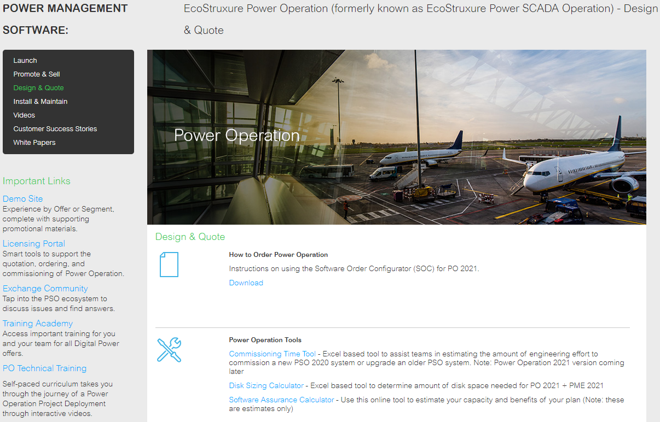
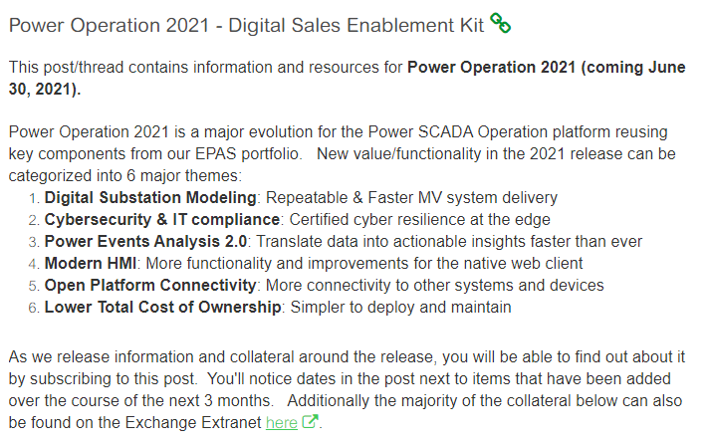
Where to find Power Operation 2021 Design & Quote collateral
OR
Power Operation 2021 - Digital Sales Enablement Kit - Exchange Community
Design & Quote - SE Exchange Extranet

Slide 23
Available now
Collateral updated for Power Operation 2021
Power Operation 2021 collateral available
Design & Quote collateral now available (1/2)
Collateral | Available on Extranet | Available on Community (SEK) | Description
How to order Power Operation | Yes | Yes | Detailed instructions for Schneider Electric teams on how to order Power Operation 2021
Disk sizing calculator | Yes | Yes | Excel based tool to determine amount of disk space needed for Power Operation and Advanced Reporting
Software assurance calculator | Yes | Yes | Excel spreadsheet tool to calculate number of software assurance credits required to entitle upgrades from previous versions of PSO to Power Operation 2020
Device support matrix | Yes | Yes | Spreadsheet with complete details of Power Operation devices included standard with the product that requires ZERO use of productivity tools.
Part numbers | Yes | Yes | Power Operation 2021 Commercial References (DMDI) is the complete reference for all Power Operation commercial parts and their associated commercial policies.

Slide 24
Available now
Collateral updated for Power Operation 2021
Power Operation 2021 collateral available
Design & Quote collateral now available (2/2)
Collateral | Available on Extranet | Available on Community (SEK) | Description
Design Guide | Yes | Yes | Reference guide in PPT form for teams designing and quoting Power Operation systems. Note: Majority of Design Guide information is also found in the Power Operation 2021 System Guide.

Slide 25
Power Operation 2021 collateral coming after the release
More Design & Quote collateral coming later…
Coming in June and after
Collateral to be updated for Power Operation 2021
Collateral | Available on Extranet | Available on Community (SEK) | Description
IT Guide | Planned for June 30 | Planned for June 30 | Power Operation 2021 information targeting the IT persona
Commissioning Time Tool | Planned soon after release | Planned soon after release | Excel based tool to assist teams in estimating amount of engineering effort to commission a new Power Operation system or to upgrade an older PSO system

Slide 26
PO 2021 Launch
Design & Quote Delta
1 – Introductions
2 – Power Operation 2021 Launch Schedule
3 – Finding Power Operation 2021 resources / collateral
4 – Power Operation 2021 What’s New (Promote & Sell recap)
5 – Design & Quote resources / collateral
6 – Design Guide What’s New
7 – How to Order Power Operation What’s New
8 – Your Questions
5’
5’
5’
10’
5’
40’
5’
15’

Slide 27
Available now
Collateral updated for Power Operation 2021
Power Operation 2021 collateral available
Design & Quote collateral now available (2/2)
Collateral | Available on Extranet | Available on Community (SEK) | Description
Design Guide | Yes | Yes | Reference guide in PPT form for teams designing and quoting Power Operation systems. Note: Majority of Design Guide information is also found in the Power Operation 2021 System Guide.

Slide 28
PO 2021 Launch
Design & Quote Delta
1 – Introductions
2 – Power Operation 2021 Launch Schedule
3 – Finding Power Operation 2021 resources / collateral
4 – Power Operation 2021 What’s New (Promote & Sell recap)
5 – Design & Quote resources / collateral
6 – Design Guide What’s New
7 – How to Order Power Operation What’s New
8 – Your Questions
5’
5’
5’
10’
5’
40’
5’
15’

Slide 29
Available now
Collateral updated for Power Operation 2021
Power Operation 2021 collateral available
Design & Quote collateral now available (1/2)
Collateral | Available on Extranet | Available on Community (SEK) | Description
How to order Power Operation | Yes | Yes | Detailed instructions for Schneider Electric teams on how to order Power Operation 2021

Slide 30
Excerpt of document.
Download full document from Exchange for complete content.
Ordering Power Operation using SOC
Information effective June 30, 2021
Schneider Electric Internal Use Only

Slide 31
Excerpt of document.
Download full document from Exchange for complete content.
1 - What’s new as of June 30, 2021
2 - How to order older versions & USB’s for Power Operation (PSO 2020, 9.0, 8.x)
3 - Overview of Power Operation software and system components
4 - Ordering Power Operation for the first time
5 - Ordering Power Operation Development Licenses
6 - Assigning activation codes for Client Access licenses
7 - Ordering a new Power Operation system (software keys)
8 - How to upgrade a Power Operation system
9 - How to add a license to an existing site
10 - Example architectures and SOC Bill of Materials
11 - Delivery Lead Times
12 - Getting Help
Ordering Power Operation using SOC

Slide 32
Excerpt of document.
Download full document from Exchange for complete content.
Other Ordering updates since PSO 2020
New content and new processes for Power Operation 2021 orders
New section covering how to order older versions of PSO 2020, PSO 9.0 and PSE 8.x: additional details
New section covering how license activation codes are grouped with special emphasis on Client Access licenses: additional details
New method for adding a license to an existing site: additional details
New example Bill of Materials covering how license activation codes should be grouped: additional details
New method for technical support help no longer leveraging Software Registration Centers: additional details

Slide 33
Excerpt of document.
Download full document from Exchange for complete content.
1 - What’s new as of June 30, 2021
2 - How to order older versions & USB’s for Power Operation (PSO 2020, 9.0, 8.x)
3 - Overview of Power Operation software and system components
4 - Ordering Power Operation for the first time
5 - Ordering Power Operation Development Licenses
6 - Assigning activation codes for Client Access licenses
7 - Ordering a new Power Operation system (software keys)
8 - How to upgrade a Power Operation system
9 - How to add a license to an existing site
10 - Example architectures and SOC Bill of Materials
11 - Delivery Lead Times
12 - Getting Help
Ordering Power Operation using SOC

Slide 34
Power Operation 2021 licenses not backwards compatible
Important change from previous versions of Power Operation
Power Operation 2021 and PME 2021 introduce a new licensing technology that provides a variety of benefits to end users.
This new licensing is different from previous versions of Power Operation (eg: PSO 2020, PSO 9.0, PSE 8.x).
A Power Operation 2021 license will not work with previous versions of Power Operation (eg: PSO 2020, PSO 9.0, PSE 8.x).
Excerpt of document.
Download full document from Exchange for complete content.

Slide 35
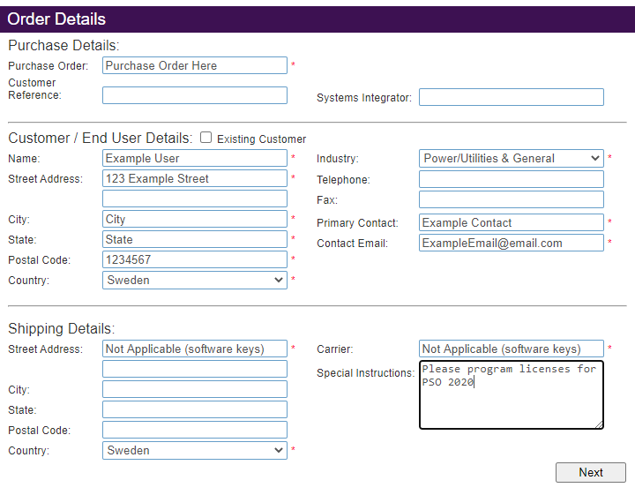
How to order older version of PSO (eg: PSO 2020, 9.0, 8x)
Indicate that you want to have a license for older version of PSO
Important points:
Unless otherwise indicated a Power Operation 2021 license will be provided.
If customer requires license for software version prior to Power Operation 2021, indicate PSO version in the “Special Instructions” in the Order Details. (see highlight in green)
Excerpt of document.
Download full document from Exchange for complete content.

Slide 36
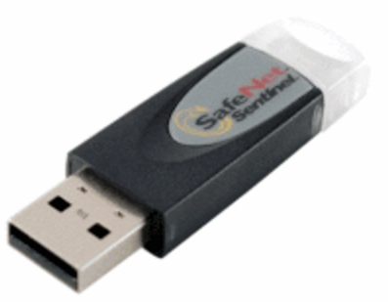
How to order older version of PSO with USB dongle
Until December 1, 2021
For teams ordering PSO 2020, PSO 9.0 that still require USB dongles, you can do so via the normal SOC process until December 1, 2021 with approval from global offer manager.
PSA109921: USB dongle
USB dongle option is not available with Power Operation 2021
Excerpt of document.
Download full document from Exchange for complete content.

Slide 37
What happens if I do not indicate that I needed an older license
Process
If a Schneider Electric front office mistakenly orders a new Power Operation 2021 license but requires a PSO 2020, PSO 9.0, PSE 8.x, etc. license, then you should:
Send an email to orders.software@schneider-electric.com with previous order id information and request an exchange of licenses for older version.
Orders.Software team will obsolete the Power Operation 2021 licenses, generate new PSO licenses and email licenses.
Excerpt of document.
Download full document from Exchange for complete content.

Slide 38
PO 2021 Launch
Design & Quote Delta
1 – Introductions
2 – Power Operation 2021 Launch Schedule
3 – Finding Power Operation 2021 resources / collateral
4 – Power Operation 2021 What’s New (Promote & Sell recap)
5 – Design & Quote resources / collateral
6 – Design Guide What’s New
7 – How to Order Power Operation What’s New
8 – Your Questions
5’
5’
5’
10’
5’
40’
5’
15’

Slide 39
Launch Schedule
Activities before and after June 30 product availability
Q1 2021
Q2 2021
Q3 2021
February
March
April
May
June
July
August
February 11
Promote & Sell Delta webinars
March
Marcom assets available &
PSO 2020 R2 CU1
April
More Marcom assets available
May 27
Design & Quote Delta webinars
June 30
Power Operation 2021 available
July - August
Delta Technical Training
+
Digitalized commercial training
Audience:
Offer managers, sales engineers and tendering teams +
EcoXperts welcome to join
Is previous experience required:
Ideally yes
Link to P&S materials shared
Audience:
Offer managers, tendering teams, PAE’s and application engineers (optional) +
EcoXperts welcome to join
Is previous experience required:
Ideally yes
Audience:
SE application engineers & EcoXpert/partners
Is previous experience required:
Required
(take advantage of Power Operation Project Deployment to get ready)

Slide 40
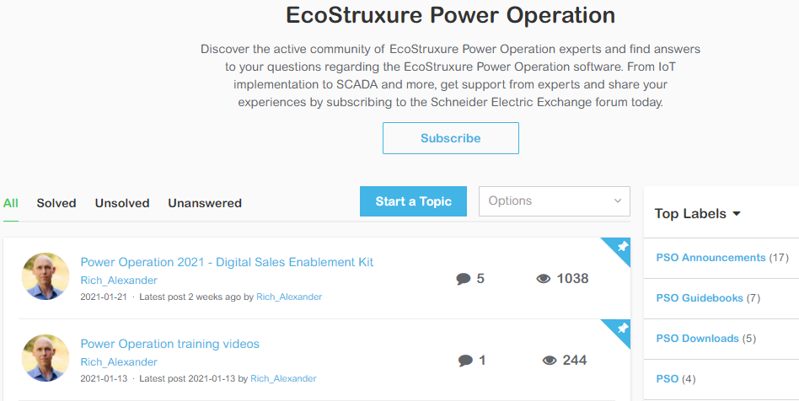
Power Operation 2021 Questions
If you have questions now or later…
Join the Power Operation 2021 Q&A discussion on Exchange Community (Sales Enablement Kit post)
https://community.exchange.se.com/t5/EcoStruxure-Power-Operation/bd-p/power-scada-operation

Slide 41
Open Standard Protocols and Data Exchange
Large variety of protocols allows for vendor agnostic equipment communication
Protocols for Connected Products | Supported
IEC 61850 Ed. 1 & Ed. 2 MMS client | yes
Modbus TCP/IP client | yes
Modbus RTU master | yes
IEC 60870-104 client | yes
DNP3.0 TCP/IP client | yes
DNP3.0 UDP client | yes
DNP3.0 Serial master | yes
BACnet/IP client | yes
SNMP 2.0 | yes
ION client | yes
KNXnet/IP 1.1 client | yes
KNX UDP 1.1 client | yes
Protocols for Data Exchange | Supported
OPC UA 1.01 client | yes
OPC UA server | yes
OPC DA 2.0 server | yes
OPC DA 2.0 client | yes
OPC AE 1.0 server | yes
EcoStruxure Web Services (EWS) 1.1 | yes
Common question around what native protocols are supported by Power Operation
Notes:
41

Slide 42
Notes:
Closing slide

